Slide 1

DIGITAL RIGHTS MANAGEMENT FOR IMAGE COPYRIGHTS
A COURSE CORE PROJECT
TEAM MEMBERS:
LOGESH S
ARUN KUMAR K
ARSHATH PARVES I
CHENNAI INSTITTUE OF TECHNOLOGY
Guide:
Dr. S. Meenakshi

Slide 2
INTRODUCTION
Steganography is the art and science of hiding the information within the digital media.
In an era of data breaches and privacy concern, secure communication plays a crucial role
Steganography provides a way to hide sensitive data within normal looking media, making it difficult for unauthorized parties to detect
It is also called as data masking because the media within which the data is hidden is acting as a mask for the data and hide its originality

Slide 3
OBJECTIVES
To provide an overview of steganography
To explore the Spread Spectrum method in steganography
To implement the data hiding using SSIS in real time

Slide 4
LITERATURE REVIEW
The name steganography is derived from Greek words that literally mean “Covered Writing”.
At the early stage, it has been mainly used for military, diplomatic.
Around 440 B.C, Demaratus sent a caution about an upcoming attack to Greece on a wax tablet. Italian mathematician Jerome Cardan discovered a method of secret writing 500 years ago.
All stated approaches are termed as mechanical steganography but the digital revolution in 21st century has made secure techniques

Slide 5
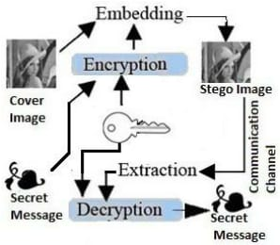
BASIC STEGANOGRAPHIC MODEL

Slide 6

TECHNOLOGY AND TOOLS USED
MATLAB
Error correction codes.
Pseudo random sequence noise
Interleaving algorithm

Slide 7
SPREAD SPECTRUM
Spread spectrum is defined as the spreading the signal over a large frequency band
Spread spectrum is also can be termed as a wideband signal in which the signal’s bandwidth is greater than the coherent band width
Spread spectrum offers robustness, security, and resistance to interference but may involve complexity, lower data rates, and spectrum utilization trade-offs.
Its suitability depends on the specific requirements of the communication application and regulatory considerations.

Slide 8
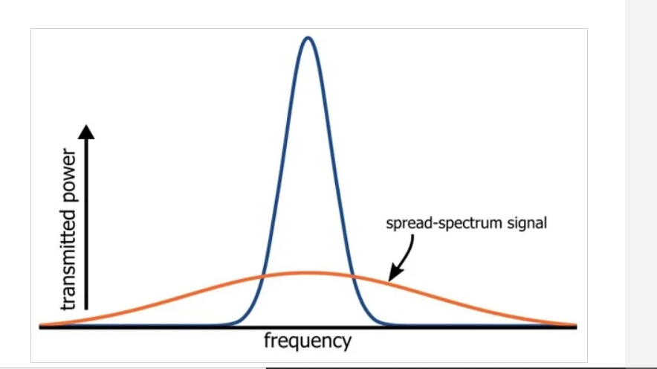
HOW SPREAD SPECTRUM HELPS?
Spread spectrum hides data within a signal by spreading it across a wide frequency range.
It uses a spreading code known only to sender and receiver, providing security.
Multiple SS-based communications can coexist without interference.

Slide 9
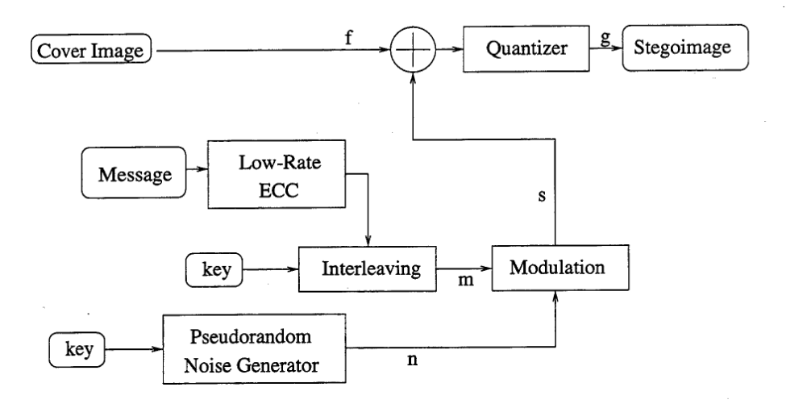
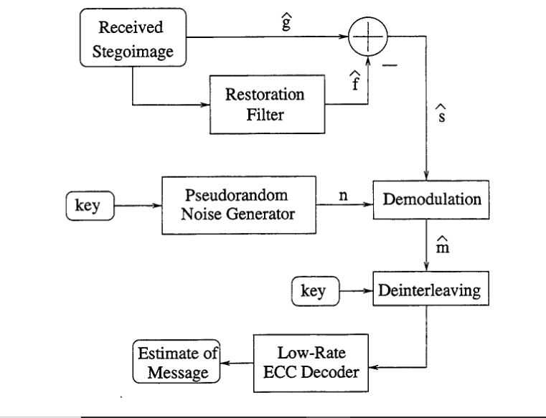
BLOCK DIAGRAM
Transmitter side
Receiver side

Slide 10
IMPLEMENTATION
function SpreadSpectrumSteganography()
% Load the cover image coverImage = imread('test_img4.jpeg');
% Convert the cover image to double precision
coverImage = im2double(coverImage);
% Embedding
% Prompt the user for a message
message = input('Enter the message to embed: ', 's');
% Convert the message to binary binaryMessage = str2bin(message);
% Generate a spreading sequence (pseudo-random sequence)
spreadingSequence = rand(size(coverImage)) > 0.5;
% Ensure binaryMessage has the same dimensions as the spreading sequence
binaryMessage = rand(size(coverImage)) > 0.5;
% Replace with your message

Slide 11
% Embed the binary message into the cover image using spread spectrum
stegoImage = coverImage + spreadingSequence .* (binaryMessage - 0.5);
% Adjust the scaling to make it centered around zero
% Display the original cover image
figure;
subplot(2, 1, 1);
imshow(coverImage);
title('Original Cover Image');
% Display the stego image
subplot(2, 1, 2);
imshow(coverImage);
title('Stego Image');
% Saving the stego image
imwrite(stegoImage, 'stego_image.jpg');
% Extraction % Prompt the user to extract the message
prompt = 'Do you want to extract the hidden message (yes/no)? ';

Slide 12
choice = input(prompt, 's');
if strcmpi(choice, 'yes')
% Display the original message
fprintf('Embedded message: %s\n', message);
else
fprintf('Extraction skipped.\n');
endend function binaryMessage = str2bin(message)
binaryMessage = dec2bin(message, 8);
% Convert to binary with 8 bits per character
binaryMessage = binaryMessage(:)' - '0'; % Convert to a binary vectorend

Slide 13
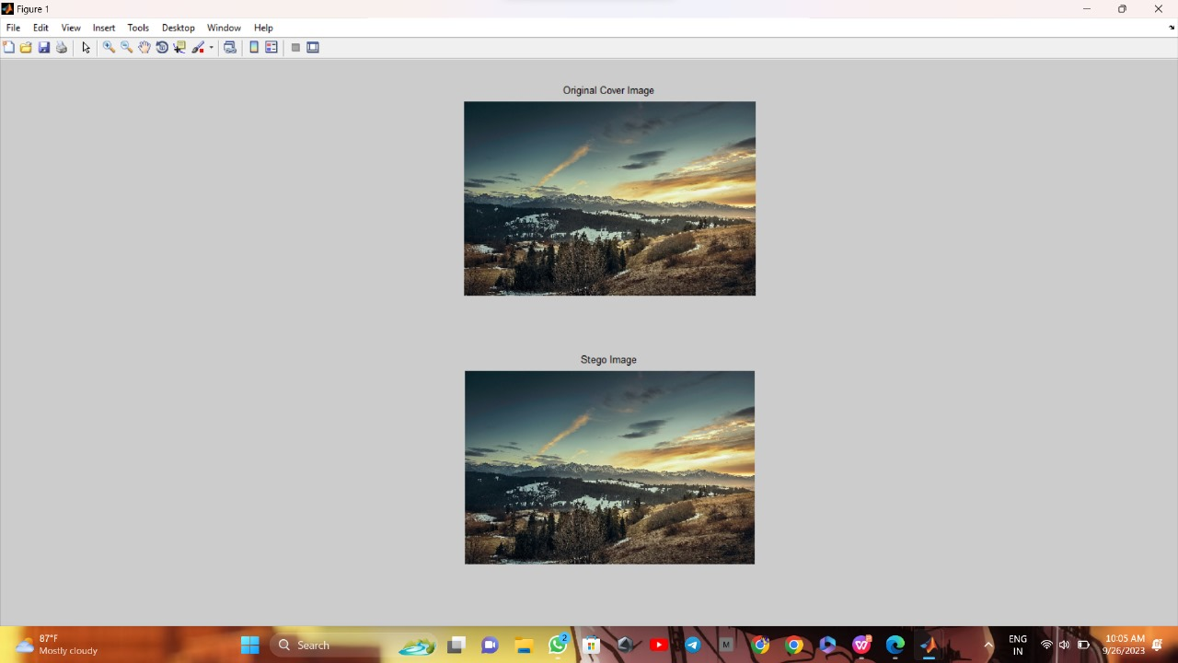
OUTPUT:

Slide 14
PROS OF STEGANOGRAPHY…
Enhanced Security
Data Protection
Authentication
Versatility

Slide 15
CONS OF STEGANOGRAPHY…
Misuse
Detection Challenges
Complexity
Limited Data Capacity
Ethical and Legal Concerns

Slide 16
APPLICATION
Secure data transmission
Copyright protection
Covert communication
Digital watermarking

Slide 17
FUTURE SCOPE
Steganography though is still a fairly new idea. These are constant advancement in the field of computer science suggesting advancement in the field of steganography
Soon ,there will be advancement in the field of steganoanalysis
It is how difficult to find the large file in a image is equivalent to finding micro-needle in a haystack
Processing required to detect the message within the sample image need to be made less by improving the efficiency of algorithm so that message should be detected with no time

Slide 18
THANK YOU :)

